Slide 1






“GROWIN’UP”
Mobile Application for primary students with Dyslexia to improve the Sinhala language

Slide 2



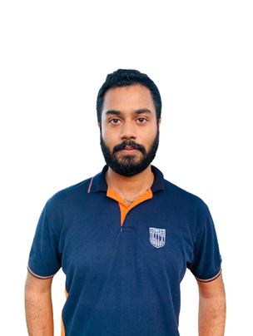

MEET OUR TEAM
IT20127428
MEDDADUWAGE P.M
IT20142346
SANDEEPA U.H.A.N
IT20139094
LIYANAGE L.T.N
IT20088828
E.N.D.S. ELAMALDENIYA

Slide 3



YOU WILL BE TAKEN THROUGH
Introduction
Research Problem
Research Objectives
Overall System Diagram
Progress Of the Research (Front-end and Back-end)
Individual Components
Future Works
Gantt Chart

Slide 4



INTRODUCTION
A revolutionary mobile app dedicated to enhancing Sinhala language skills for primary students with dyslexia. Dyslexia can pose significant challenges in mastering one's native language, and "Growin'Up" seeks to bridge this gap.

Slide 5



WHAT WILL BE FOUCESD?
Analyzing sequential difficulties faced by the kids of the age limit of 6-8.
Effects of phonological dyslexia, when learning letters, spellings and their sounds.
Identifying the number learning difficulties faced by the dyslexic students.
Researching on rapid naming dyslexia and focusing on reading disabilities faced by dyslexic students.

Slide 6
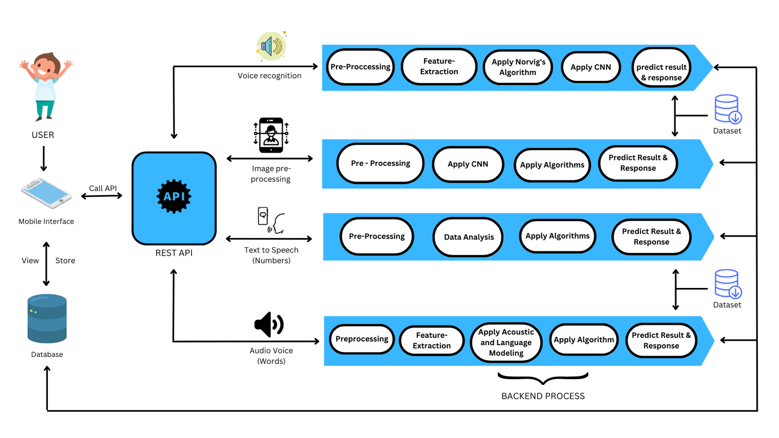
OVERALL SYSTEM DIAGRAM

Slide 7


PROGRESS OF THE RESEARCH

Slide 8

PROGRESS OVERVIEW DIAGRAM
Pending Task
10%
Initial Tasks
25%
Testing
10%
Implementation
25%
Design
30%

Slide 9





SCHOOL LICENSE (RS. 1000 PER USER)
MONTHLY SUBSCRIPTION
(RS. 1500)
PREMIUM SUBSCRIPTION (RS. 2000)
FREE TRIAL PERIOD
SOCIAL MEDIA COMMERCIALIZATION
Attract users with a 3-month free trial
COMMERCIALIZATION ASPECTS
5-Step Ordering Process

Slide 10



INDIVIDUAL COMPONENTS

Slide 11

IT20127428
MEDDADUWAGE P.M
COMPONENT 01
ANALYZING SEQUENTIAL DIFFICULTIES FACED BY THE KIDS OF THE AGE LIMIT OF 6-8 AND THE IMPACT OF VISUAL DYSLEXIA AND PROVIDING SOLUTIONS TO OVERCOME THEM

Slide 12


MAIN OBJECTIVE
SOLUTION IDENTIFIED
To identify the specific sequential difficulties faced by children aged 6-8 with visual dyslexia and the impact of these difficulties on their academic performance.
combines sound effects, visual feedback, phonics-based games, and auto-correction algorithms to assist dyslexic learners in improving Sinhala language skills.

Slide 13
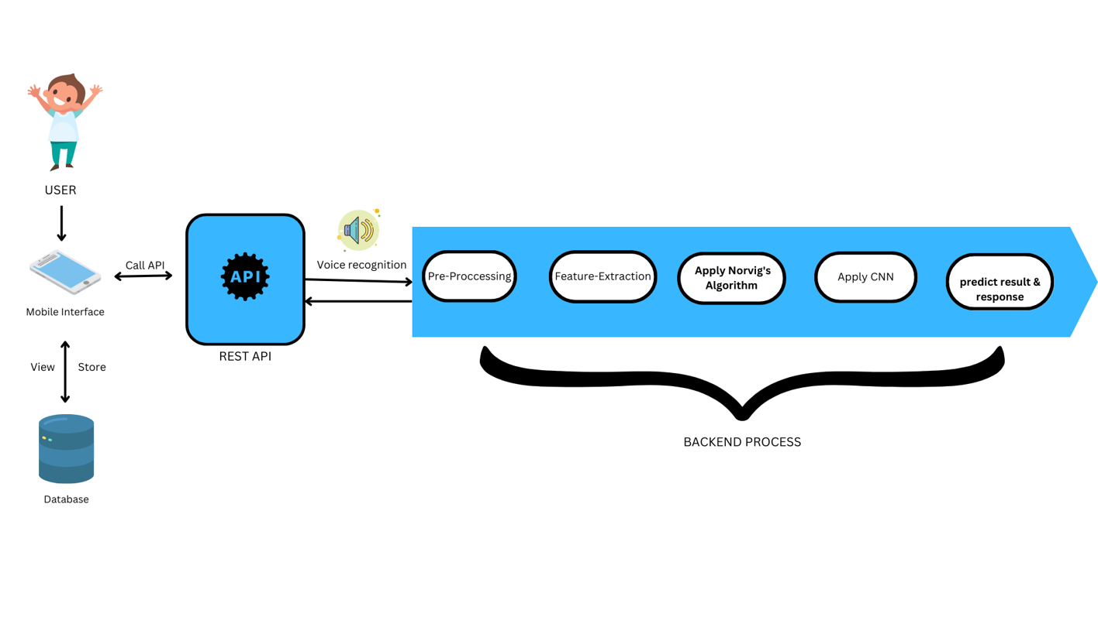
COMPONENT OVERVIEW DIAGRAM

Slide 14
PROGRESS OVERVIEW DIAGRAM
1
2
3
4
REQUIREMENT GATHERING
DATA COLLECTION
FRONT-END DEVELOPMENT
BACKEND-DEVELPOMENT

Slide 15
FUTURE IMPLEMENTATION
Complete the mobile application
Usbility testing
Implement the dashboad
Futher develop the quiz features
5
Finalize the front end
4
3
2
1

Slide 16
IT20142346
SANDEEPA U.H.A.N
COMPONENT 02
EFFECTS OF PHONOLOGICAL DYSLEXIA, WHEN LEARNING LETTERS, SPELLINGS AND THERE SOUNDS AND PROVIDING SOLUTIONS TO OVERCOME THE LEARNING DIFFICULTIES

Slide 17


MAIN OBJECTIVE
SOLUTION IDENTIFIED
Investigate the effects of phonological dyslexia on learning letters, spellings, and their sounds, and to identify effective strategies for overcoming the associated learning difficulties.
Image pre-processing, enabling kids to upload words and letters images content for assessment. It utilizes language models for text infilling, aiding letter comprehension. Puzzle games enhance memory skills.

Slide 18
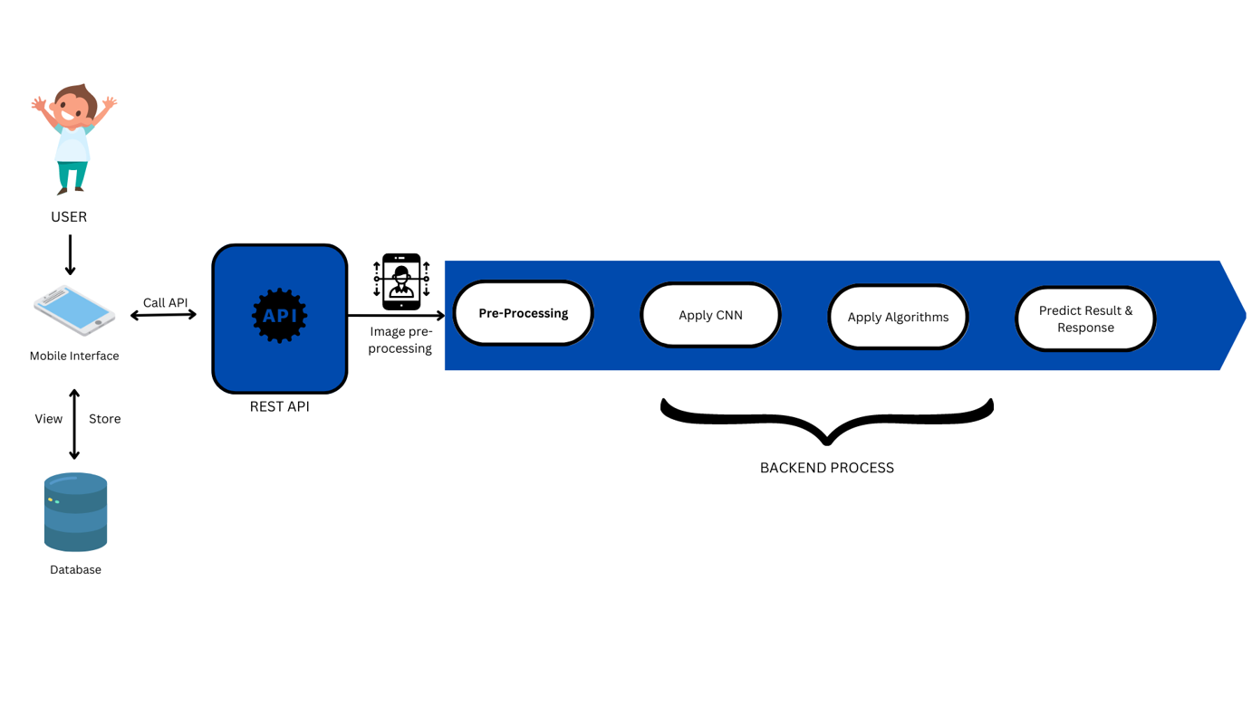
COMPONENT OVERVIEW DIAGRAM

Slide 19
PROGRESS OVERVIEW DIAGRAM
1
2
3
4
REQUIREMENT GATHERING
DATA COLLECTION
FRONT-END DEVELOPMENT
BACKEND-DEVELPOMENT

Slide 20
FUTURE IMPLEMENTATION
Complete the mobile application
Usbility testing
Implement the dashboad
Futher develop the quiz features
5
Finalize the front end
4
3
2
1

Slide 21


IT20139094
L.T.NAVINDA LIYANAGE
COMPONENT 03
IDENTIFYING THE NUMBER LEARNING DIFFICULTIES FACED BY​
DYSLEXIC STUDENTS WITH PROVIDING THE POSSIBLE ​
SOLUTIONS TO OVERCOME THEM

Slide 22
MAIN OBJECTIVE
SOLUTION IDENTIFIED
Dyscalculia challenges math comprehension and requires varied intervention strategies. Early detection depends on effective assessment protocols, while technology plays a crucial role in number learning. Dyscalculia has social and emotional impacts, emphasizing the importance of research collaboration to support affected students.
Automatic Speech Recognition to develop a speech-to-text calculator, simplifying mathematical operations for children. Additionally, we design interactive activities to enhance their logical thinking skills. To monitor their progress effectively, we offer a personalized dashboard.

Slide 23
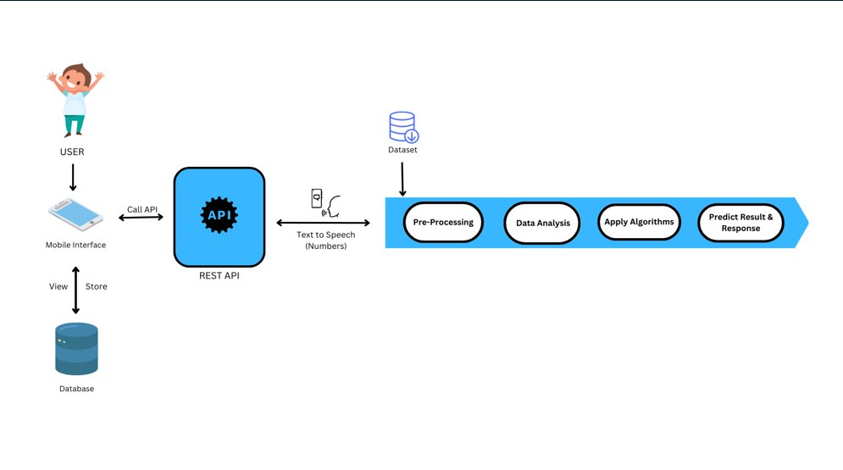
COMPONENT OVERVIEW DIAGRAM

Slide 24
PROGRESS OVERVIEW DIAGRAM
1
2
3
4
REQUIREMENT GATHERING
DATA COLLECTION
FRONT-END DEVELOPMENT
BACKEND-DEVELPOMENT

Slide 25
FUTURE IMPLEMENTATION
Usbility testing
Complete the web application
Implement the dashboad
5
Futher develop UI Changers
4
Finalize the front end
3
2
1

Slide 26
IT20088828
ELAMALDENIYA E.N.D.S
COMPONENT 04
RESEARCHING ON RAPID NAMING DYSLEXIA AND FOCUSING ON READING DISABILITIES FACED BY DYSLEXIC STUDENTS.

Slide 27
MAIN OBJECTIVE
SOLUTION IDENTIFIED
To investigate the relationship between rapid naming ability and reading fluency in individuals with rapid naming dyslexia, and to determine the effectiveness of visual processing interventions in improving rapid naming ability and reading outcomes in this population.
Will use Audible to enable listening and reading
of text, with voice recognition to identify
phrases, Will feature adjustable audio playback speed settings, ​​Will Use contextual text highlighting, ​A quiz mode will also be included
to test their memory capacity.

Slide 28
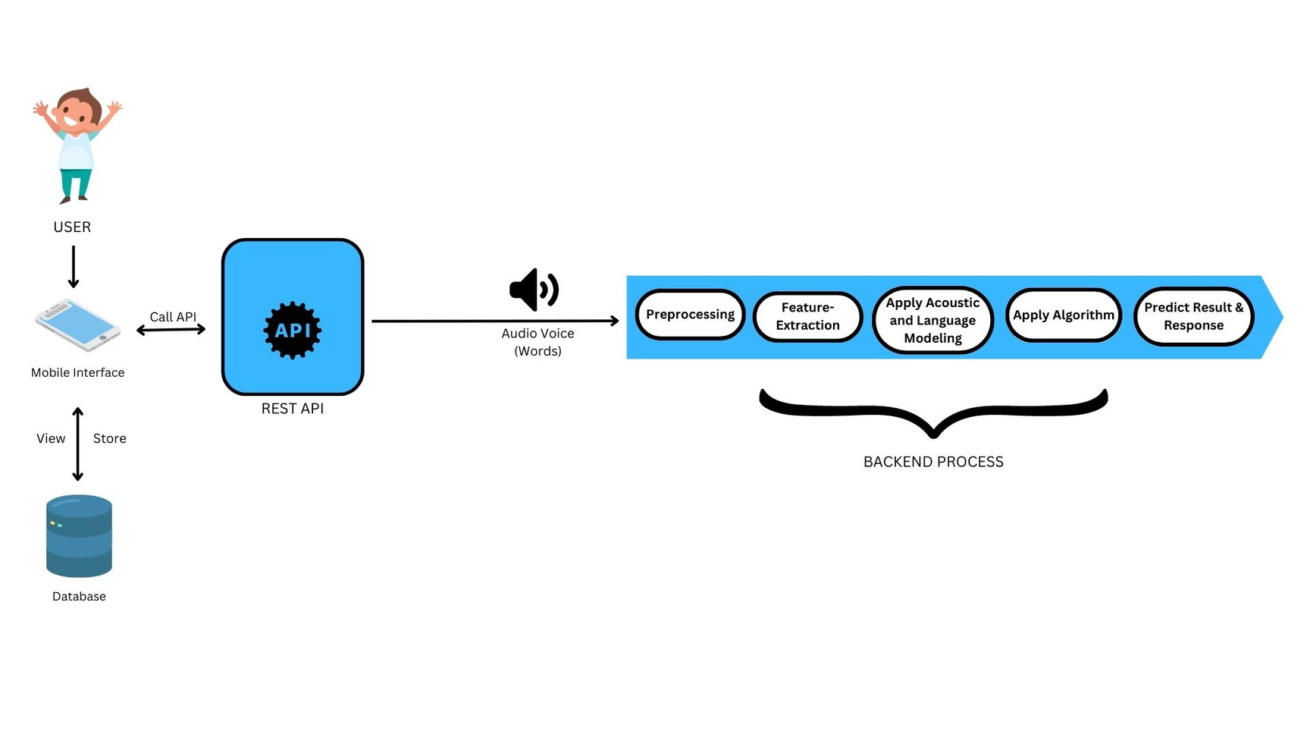
COMPONENT OVERVIEW DIAGRAM

Slide 29
PROGRESS OVERVIEW DIAGRAM
1
2
3
4
REQUIREMENT GATHERING
DATA COLLECTION
FRONT-END DEVELOPMENT
BACKEND-DEVELPOMENT

Slide 30
FUTURE IMPLEMENTATION
Complete the web application
Usbility testing
Implement the dashboad
Futher develop the quiz features
5
Finalize the front end
4
3
2
1

Slide 31



DEMO

Slide 32

THANK YOU!

Slide 33
Overall Project Description
This section should include
Research Problem
Research Objectives
Overall solution as a system diagram
Note: You should use “Overall Title and Content” Slide layout to add the details

Slide 34
Use Slide Layout “Overall Title and Content”
You may use figures, descriptions, and facts related to give an overall idea about your system.
It is better a person, who is very good at presenting, does this explanation
Following information should be covered in this section
Introduction to the overall project
Research Question
Objectives
Overall System Diagram
Then you can proceed to the individual student explanation

Slide 35
ITXXXXXXXX | <<Student Name>> | <<Project ID>>

Slide 36
This section MUST include following sections
Research Question
Specific and Sub Objectives
Evidences for the completion
Note: You should use “Individual Title and Content” Slide layout to add the details

Slide 37
Research Question, Specific and Sub Objectives
Use the slide layout “Individual Title and Content”
ITXXXXXXXX | <<Student Name>> | <<Project ID>>

Slide 38
Methodology
Use the slide layout “Individual Title and Content”
ITXXXXXXXX | <<Student Name>> | <<Project ID>>

Slide 39
Completion of the project
Use the slide layout “Individual Title and Content”
ITXXXXXXXX | <<Student Name>> | <<Project ID>>

Slide 40
ITXXXXXXXX | <<Student Name>> | <<Project ID>>

Slide 41
This section MUST include following sections
Research Question
Specific and Sub Objectives
Evidences for the completion
Note: You should use “Individual Title and Content” Slide layout to add the details
ITXXXXXXXX | <<Student Name>> | <<Project ID>>

Slide 42
Research Question, Specific and Sub Objectives
Use the slide layout “Individual Title and Content”
ITXXXXXXXX | <<Student Name>> | <<Project ID>>

Slide 43
Methodology
Use the slide layout “Individual Title and Content”
ITXXXXXXXX | <<Student Name>> | <<Project ID>>

Slide 44
Completion of the project
Use the slide layout “Individual Title and Content”
ITXXXXXXXX | <<Student Name>> | <<Project ID>>

Slide 45
References
Use IEEE referencing format

